Slide 1
Science Understanding
Human Variation
Evidence for Evolution

Slide 2
Evolution
Evolution can be defined as:
the gradual process of change in the inherited traits of a population of organisms from one generation to the next.
or
A permanent change in a population’s gene pool from one generation to the next.

Slide 3
Evidence that supports evolution
Is there evidence: -
that things have changed over time?
of common ancestry?
of increasing complexity over time?

Slide 4
Evidence for evolution
Evidence for evolution can be obtained from
many sources. For example:
Comparative studies of DNA
Amino acid sequencing in proteins
Comparative anatomy
  Homologous structures
  Embryology
Fossils

Slide 5
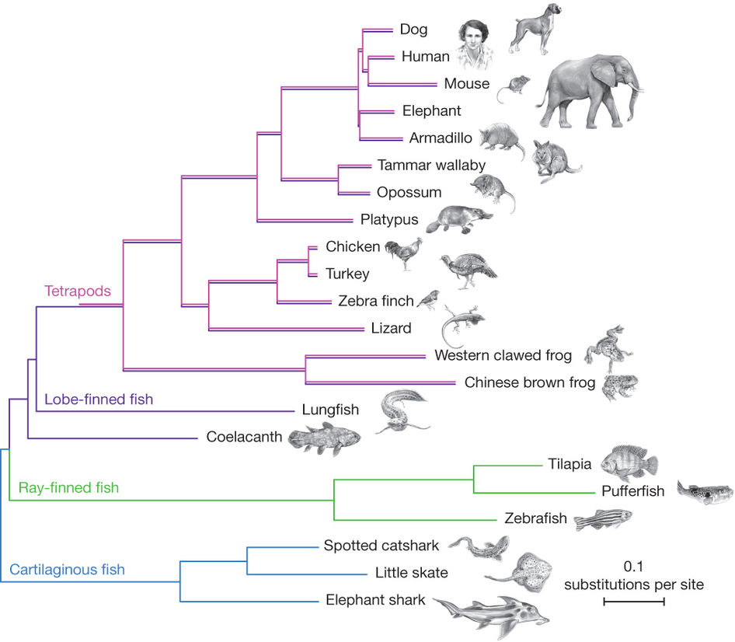
Phylogenetic Tree

Slide 6
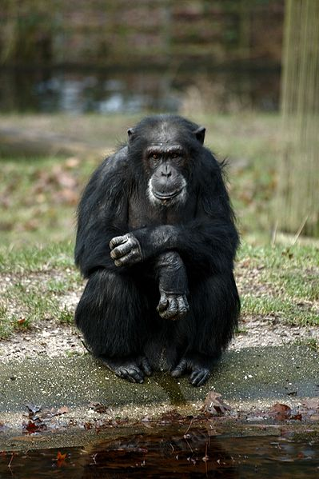
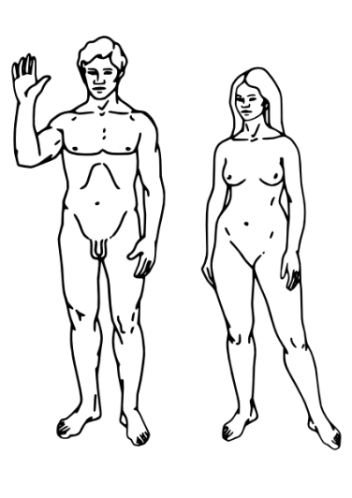
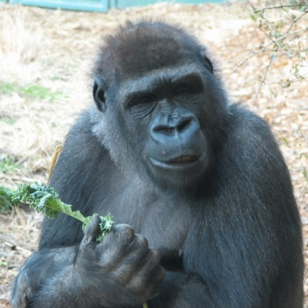
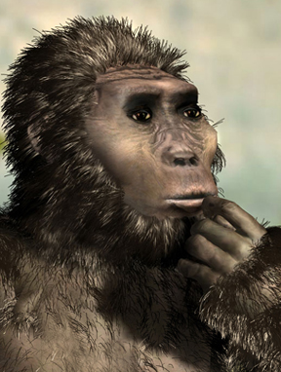
Comparative studies of DNA
DNA is made of long chains of nucleotides
Sequences of bases (A, T, C, G) are very similar in closely related species.
Sequences less similar in more distantly related species.
The similarity of the DNA indicates evolution from a common ancestor.

Slide 7
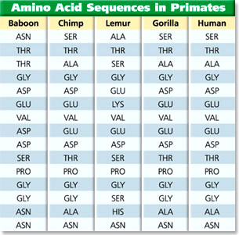
Amino acid sequencing
Proteins are made of long sequences of amino acids
Sequences are very similar in closely related species
Sequences less similar in more distantly related species
Indicates evolution from common ancestor

Slide 8
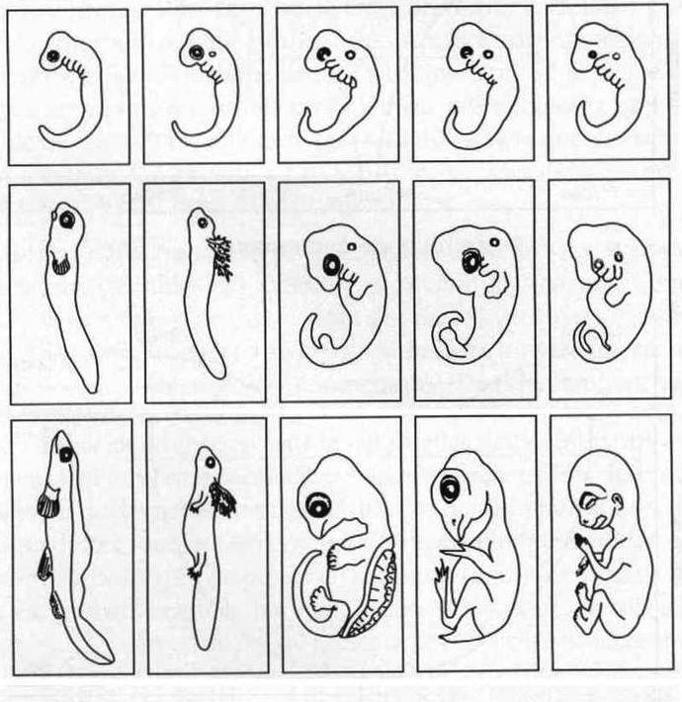
Comparative embryology
A
B
C
D
E
Many vertebrate embryos are similar.
Many have features not present in adult e.g. gills, tail.
Common developmental pathway depends on closeness of relationship.
These provide evidence of common ancestry.
A Fish; B Salamander; C Turtle; Chicken; E Human

Slide 9
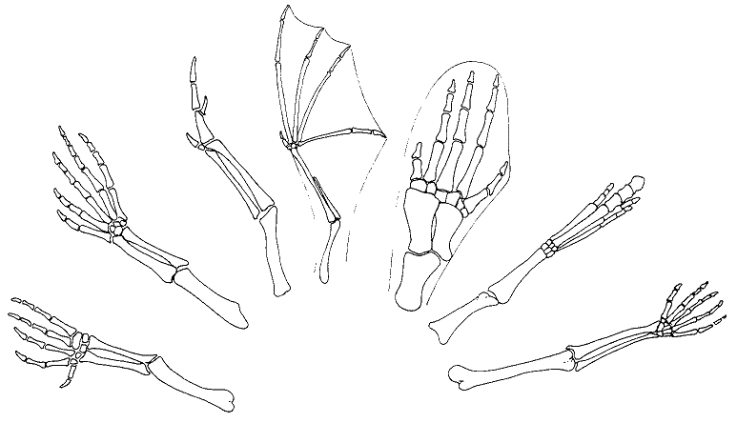
Homologous structures
Bat
Whale
Bird
Fossil horse
Crocodile
Lizard
Human
Structures with a similar architecture
e.g. pentadactyl limb in vertebrates
Similar structures but different functions?
Evidence of common ancestry

Slide 10
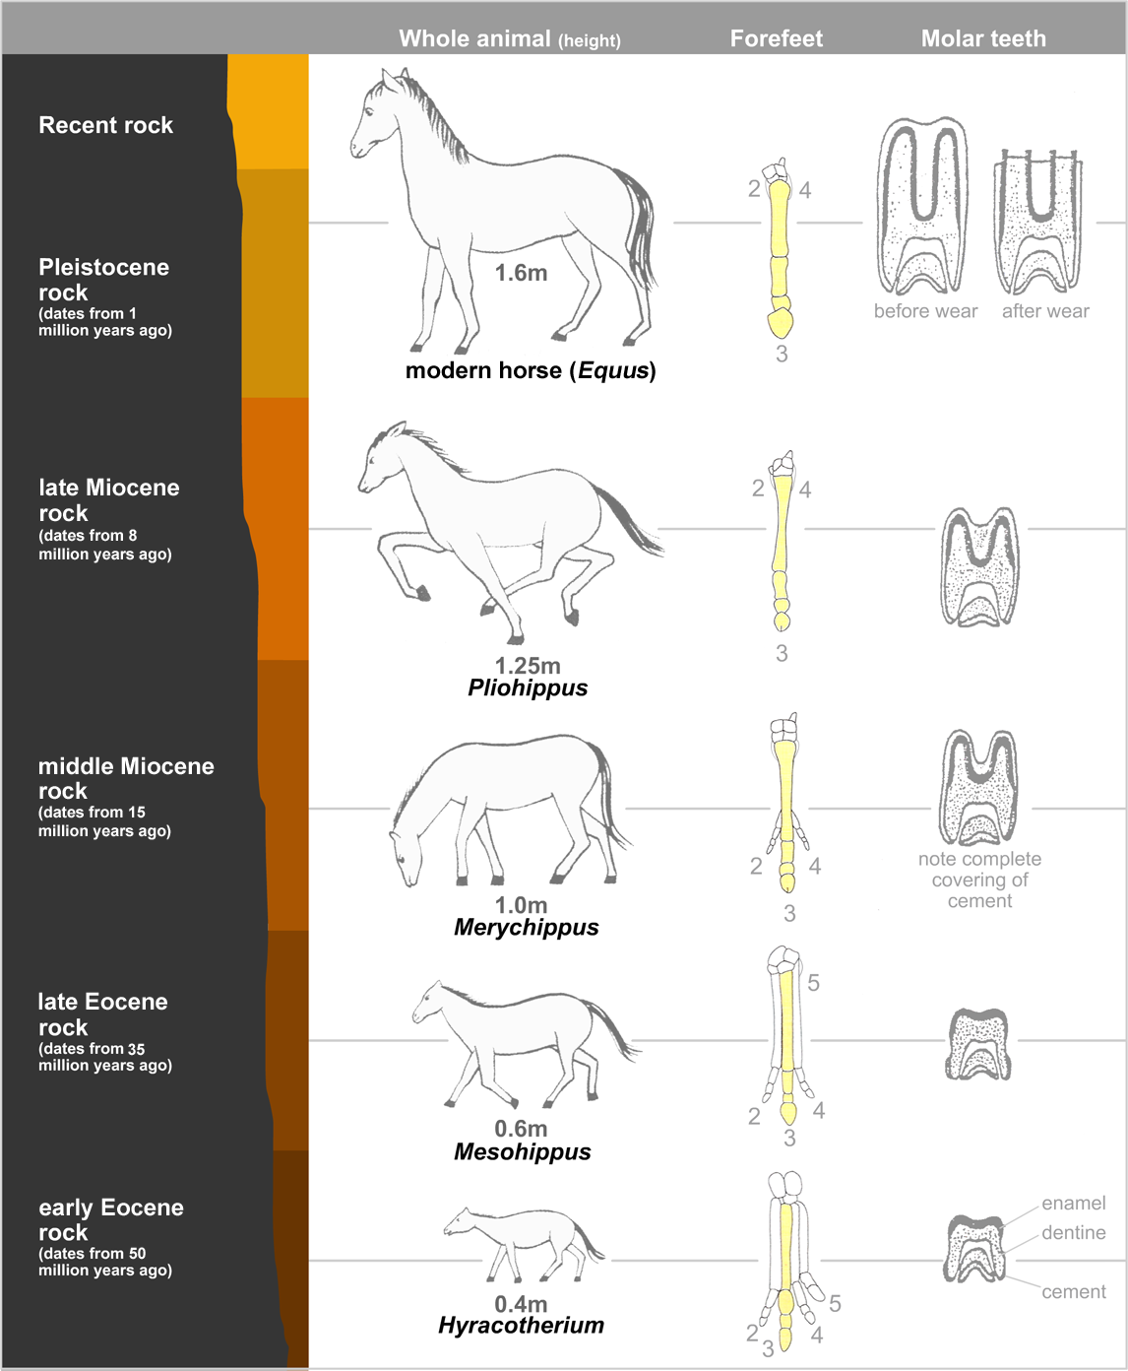
The fossil record
Organisms in the past were NOT the same as organism alive today e.g. the phylogeny of the horse.

Slide 11
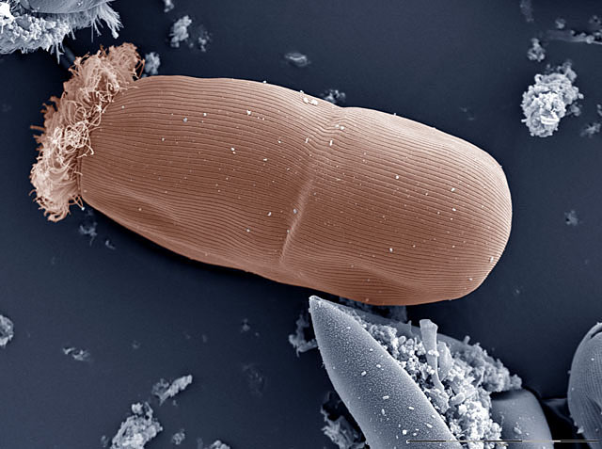
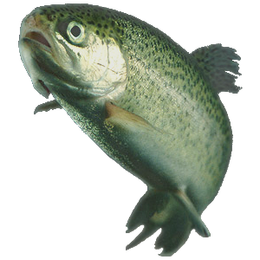
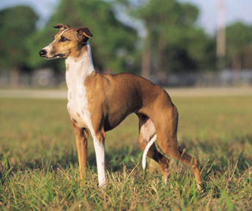
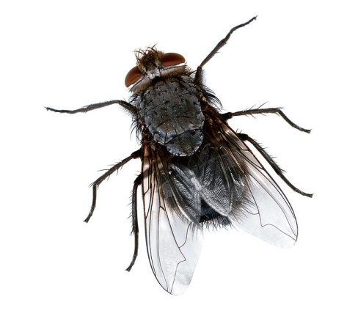
The fossil record - 2
Organisms have become more complex over time
e.g. protists→invertebrates→vertebrates.

Slide 12
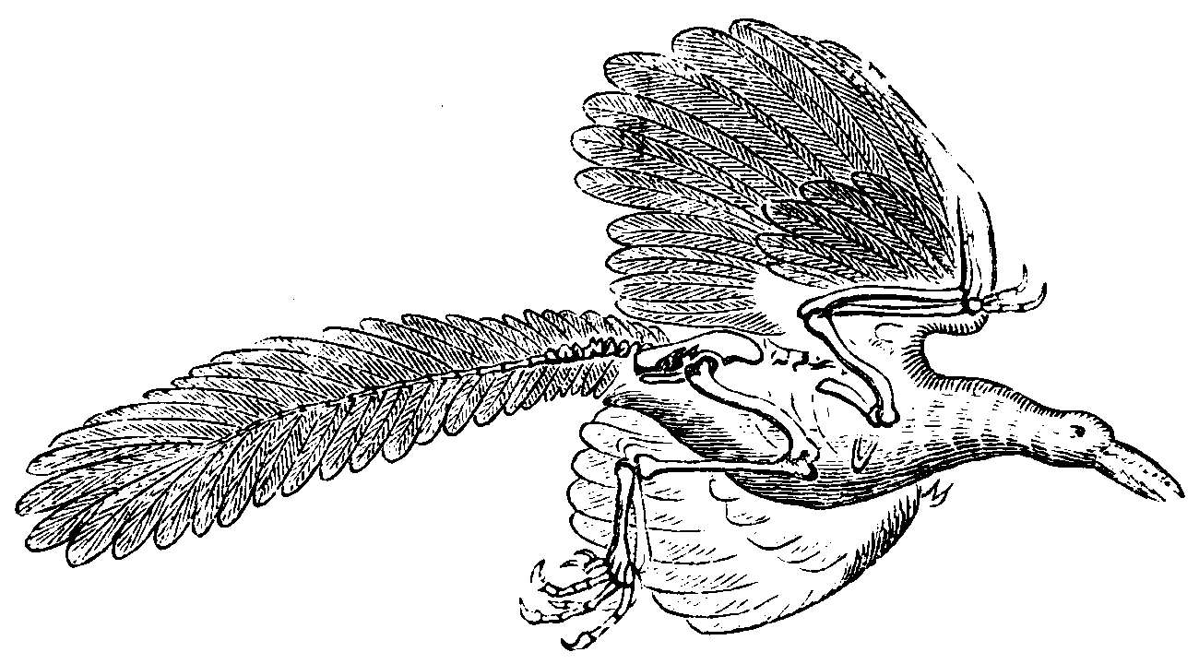
The fossil record - 3
Missing links – the common ancestors
e.g. Archaeopteryx.

Slide 13
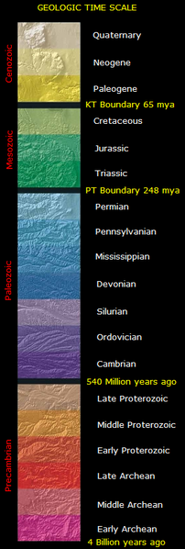
The geological time scale
The geological time scale is a model used by geologist in which the geological history of the earth is divided into units (eons, eras, periods and epochs).

Slide 14
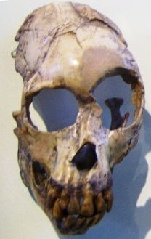
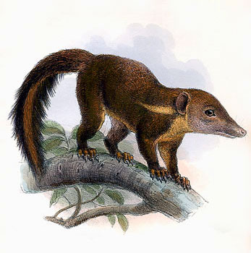
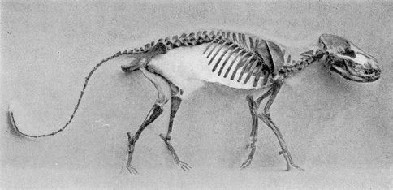
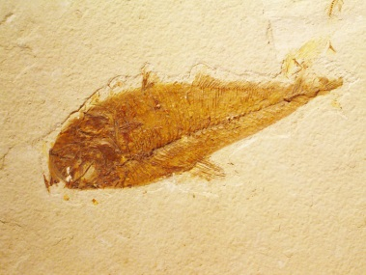
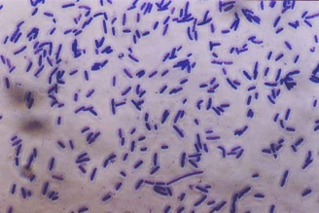
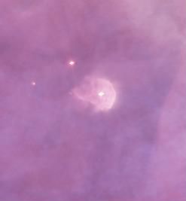
First hominids
5 million yr?
First primates
65 million yr
First mammals
200 million yr
First vertebrates
450 million yr
Appearance of life
3.5 billion yr
Origin of the earth
4.5 billion yr

Slide 15
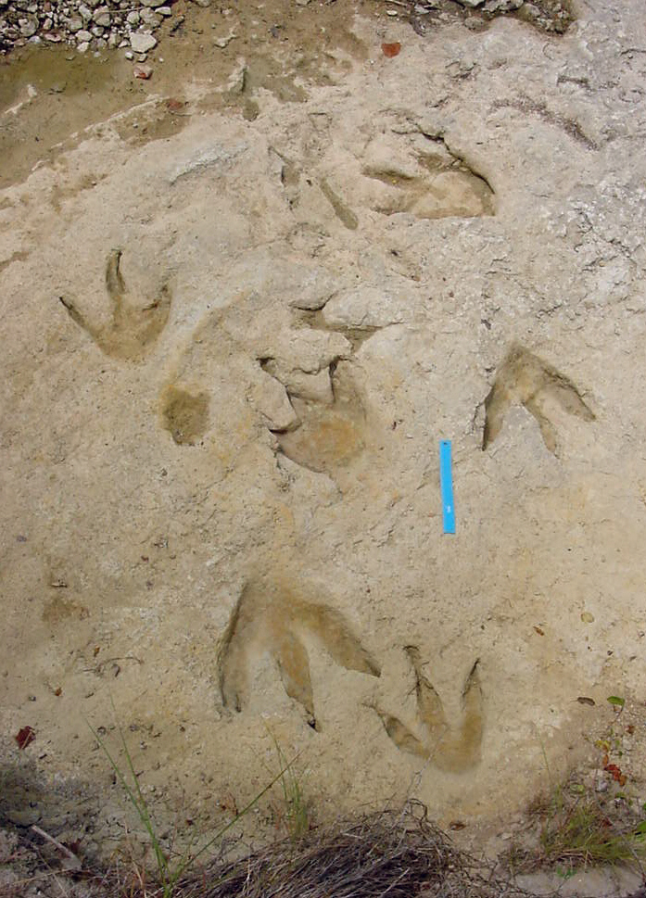
Fossils and fossilisation
Fossil dinosaur footprints
Glen J Kuban
Fossils are the preserved remains, or traces, of once-living organisms.

Slide 16
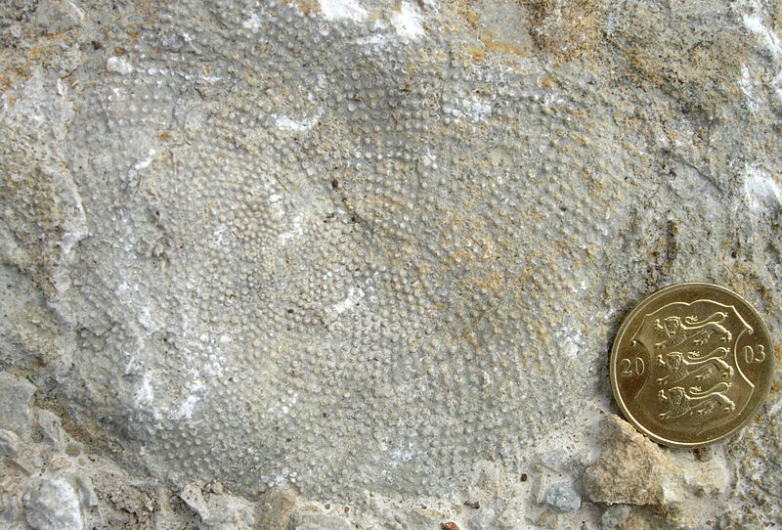
So – you want to be a fossil?
( a D.I.Y. guide to fossilisation)
Sometimes soft tissues, such as the algae shown above, are preserved; however, it is much more common for hard tissues, such as bone or shell, to be fossilised.

Slide 17
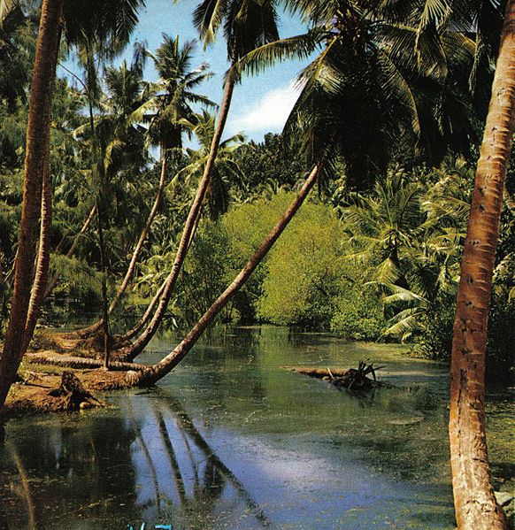
Die in water, not on land. Your remains are more likely to be buried by sediment and less likely to be destroyed by scavengers or erosion.
Choose a low energy environment (a lake or swamp). Your remains are less likely to be destroyed by mechanical processes.

Slide 18
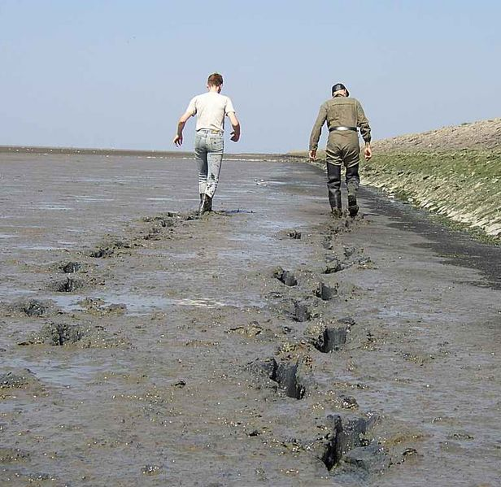
The finer the sediment (e.g. mud) the better. This excludes oxygen and slows bacterial decay, enabling soft tissues to be preserved.

Slide 19
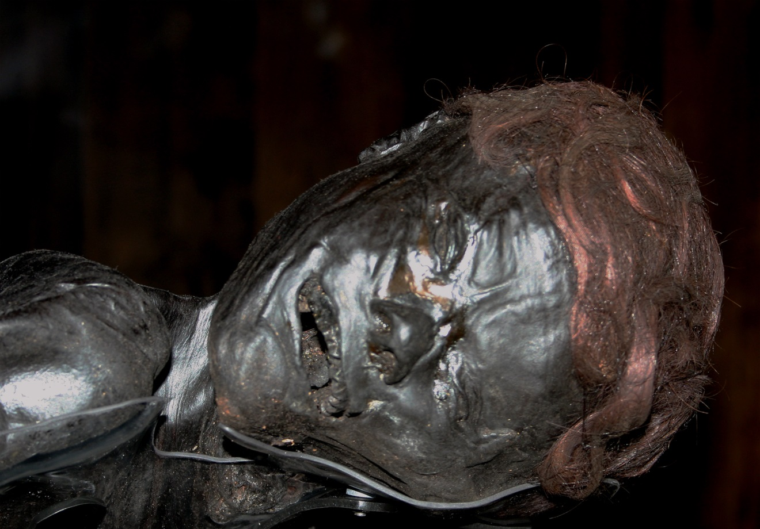
Grauballe man -
a Danish Iron Age bog burial
Malene Thyssen
Rapid burial by sediments protects your remains from scavengers and mechanical damage.
An alkaline environment favours the preservation of hard parts. An acid environment favours the preservation of soft parts.

Slide 20
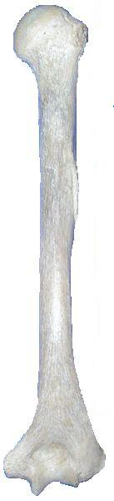
Mineral replacement
There are varying degrees of mineral replacement (0 -100%).
Stage 1 - Minerals from groundwater fill pores in the bone or shell (permineralisation).
Stage 2 – minerals forming the bone matrix, or shell, are dissolved away and replaced by minerals in the groundwater.
Minerals dissolved from bone matrix
Minerals deposited from groundwater

Slide 21
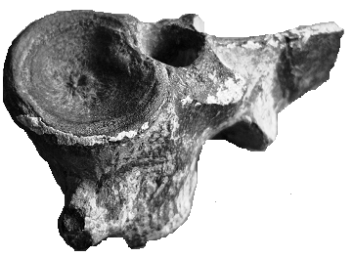
Mineral replacement
206 million year old Ichthyosaur
vertebrae from the Jurassic

Slide 22
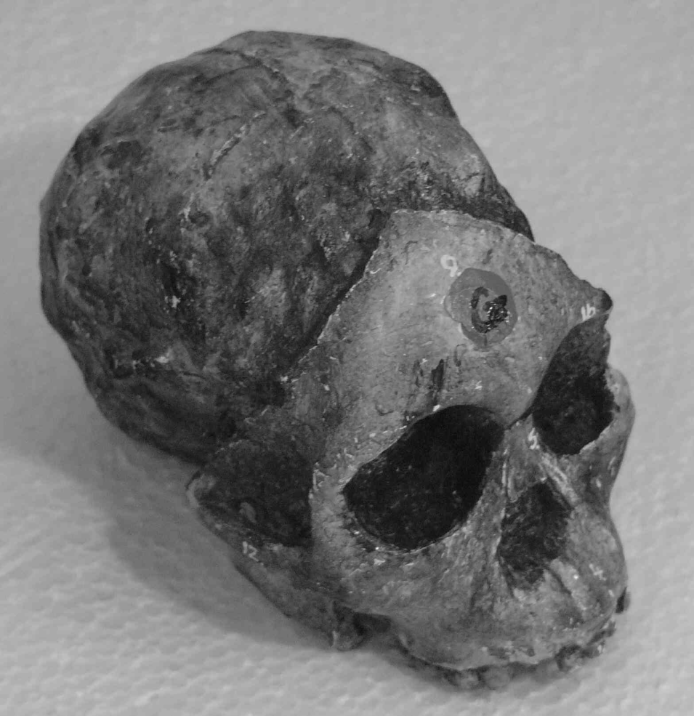
The Taung child
Fossils formed by mineral replacement provide a three-dimensional replica of the original material.
In the fossil opposite, the facial bones (formed by mineral replacement) have broken away to reveal an endocast of the brain -
(an endocast is a cast fossil formed when an empty cavity, such as the cranium, is filled with mud).

Slide 23
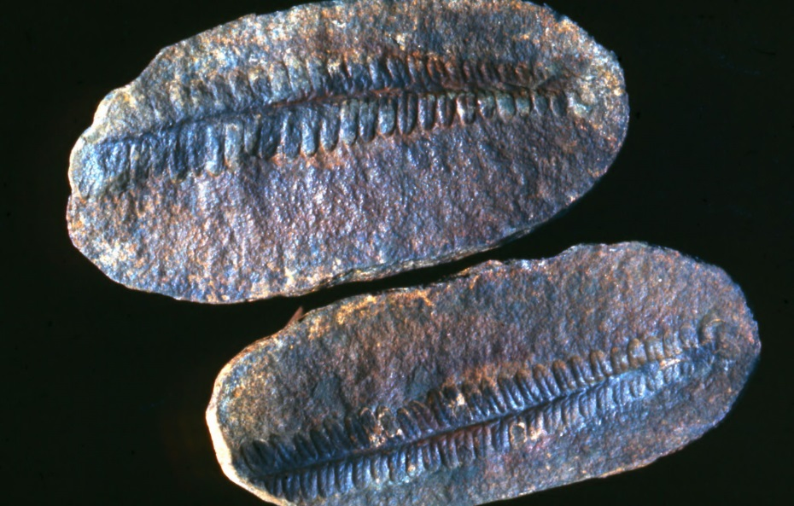
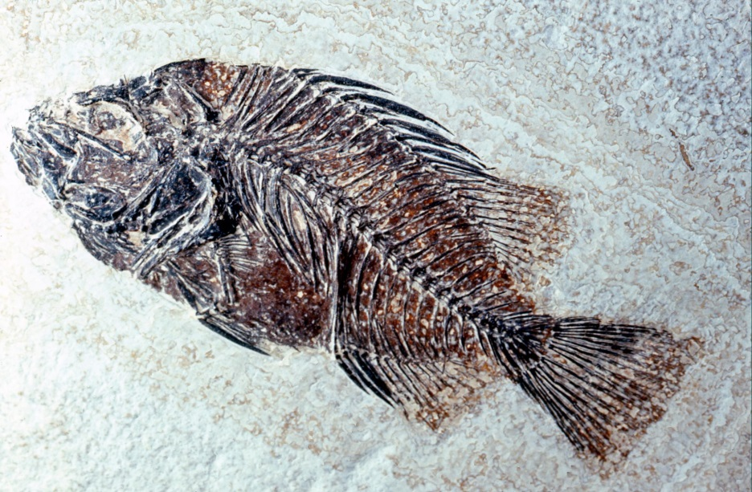
Carbonisation
Carbonised fossils provide a two-dimensional carbon impression of an organism.
Carbonisation usually occurs in very fine-grained rocks and can preserve both soft and hard tissues.
Carbonisation often occurs hand-in-hand with mineral replacement (e.g. the fish fossil).
Dave Dyet

Slide 24

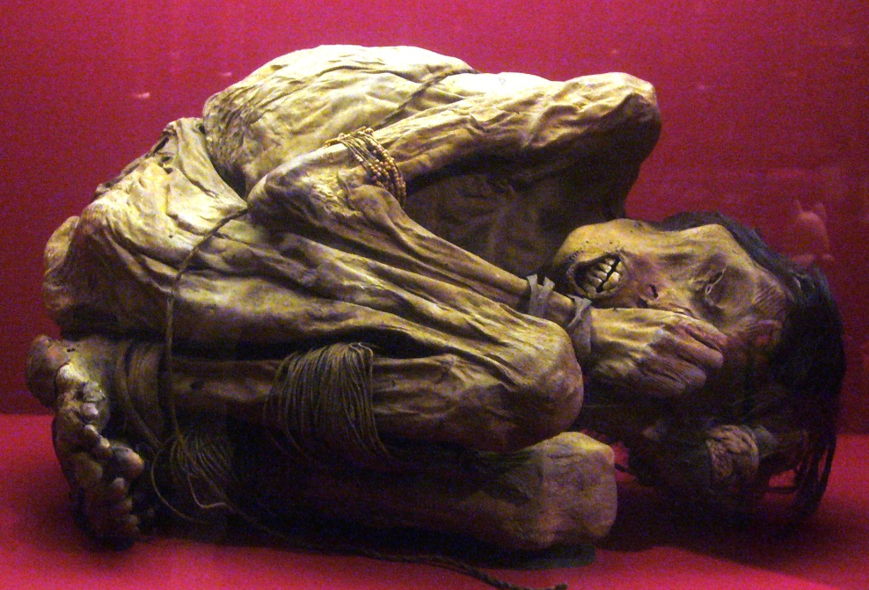
Mummification
Mummification occurs when soft and/or hard tissues are exposed to chemicals, extreme cold, very low humidity, or lack of air (e.g. when bodies are sealed in fine sediment, resin or tar).
A
Malene Thyssen
B
A – Bog burial, Denmark; B – Mummy, South America

Slide 25
Relative dating
Relative dating compares the age of one thing with that of something else
e.g. A is older than B.
Examples include:
  Superposition (for a single outcrop)
  Comparative stratigraphy (for 2 or more
  outcrops)
  Index fossils (for 2 or more outcrops)
  Fluoride dating

Slide 26
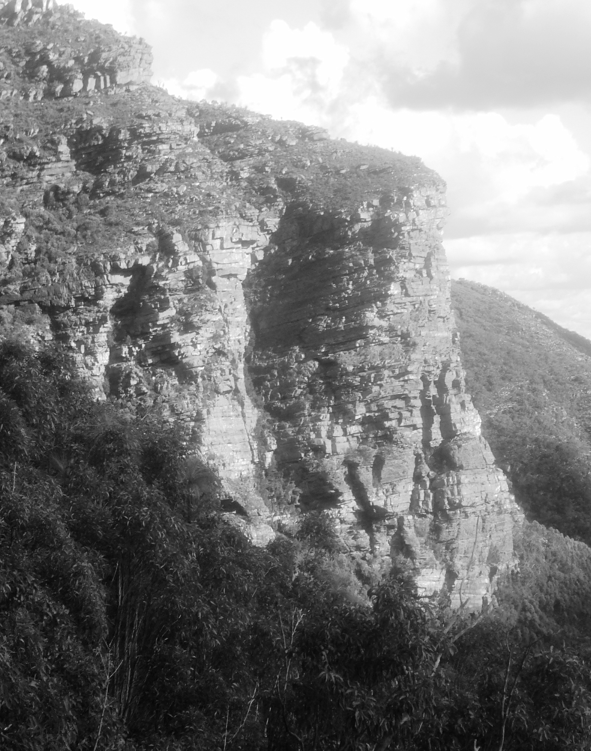
Superposition
Youngest
Youngest bed
Oldest bed
Oldest
Unless disturbed, the lower beds in a sedimentary sequence are older than the rocks above.

Slide 27
Comparative stratigraphy
Location B
Location A
Matching
beds
Stratigraphy is the study of sedimentary rocks.
If the sequence of sedimentary rocks in different areas is similar it is likely that they are of the same age.

Slide 28
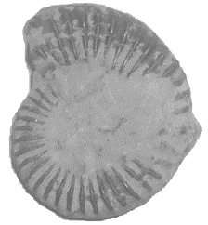
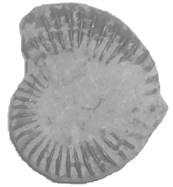
Index fossils
Index
fossils
An index fossil is a fossil of a species that can be used for relative dating.
Index fossils are of distinctive appearance, have a short time span and have a broad geographical distribution.
If rocks in different locations contain the same index fossils, it is likely that both areas are of the same age.

Slide 29
Fluorine dating
F
F
Bones buried in the same environment absorb fluorine at the same rate.
If bones found at the same location contain the same concentration of fluorine, it can be assumed that they are of the same age.

Slide 30
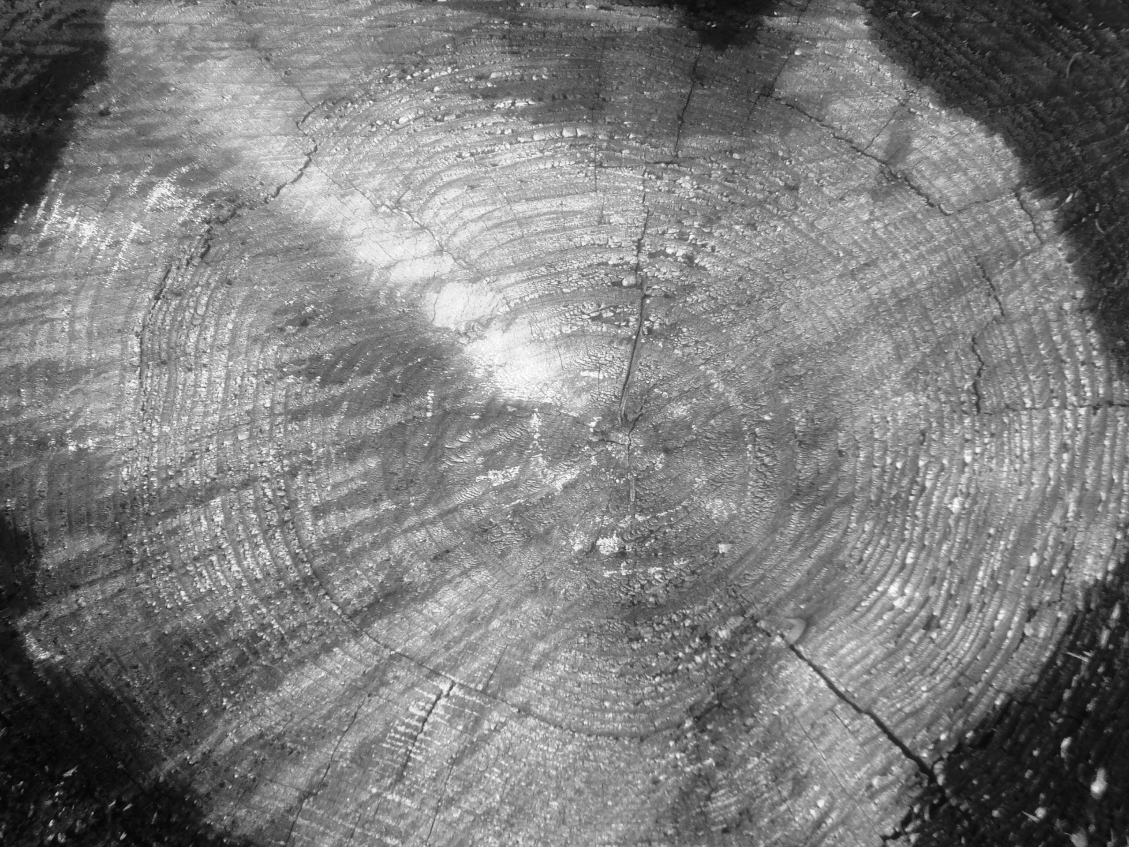
Absolute dating
Absolute dating tells you the chronological age of an object (e.g. 500 yr).
Absolute, or chronological dating, is based on any event which occurs at a constant rate or is repeated at regular intervals and is measurable.
e.g. Tree ring dating
  Sedimentation
  Palaeomagnetism
  Fission tracks
  Radiometric/radioisotope
  Luminescence
Each concentric ring represents one year’s growth

Slide 31

Radiometric/radioisotope dating

Slide 32
Radiometric dating
Radiometric (also known as radioisotope or radioactive) dating is an absolute dating method for determining the chronological age of a rock or mineral by measuring the proportions of an original radioactive material and its decay product.

Slide 33
Radioisotope
Some elements have more than one atomic form (same atomic number but with different numbers of neutrons) – these are referred to as isotopes.
Radioisotopes are unstable and break down or decay to form more stable isotopes of another element (the daughter product). Radioisotopes are radioactive, emitting radiation as they undergo decay, which can be measured.
e.g. Carbon-14 Nitrogen-14

Slide 34
Half life
Half lives
2
Original mass of radioisotope
1
4
3
Residual radioisotope
Each isotope has a unique rate of decay described as its half life (i.e. the time taken for half of any given amount of the isotope to decay).
e.g. Carbon-14 5 730 yr (half life) Nitrogen-14

Slide 35
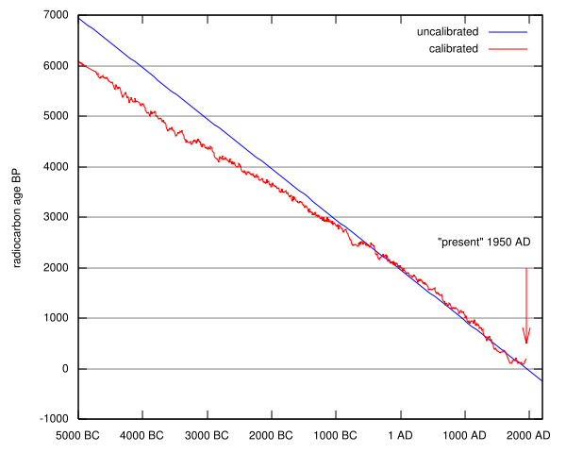
Half life decay curve for carbon fourteen

Slide 36
Radioisotopes commonly used for radiometric dating
Carbon-14 (5730 years)→ Nitrogen-14
Potassium-40 (1.3 billion years)→ Argon-40
Rubidium-86 (18.66 days) → Strontium
Uranium-238 (4.5 billion years) → Lead

Slide 37
Luminescence
Luminescence is a fairly recent technique used for dating artifacts such as stone tools and pottery.
When crystals of thorium and potassium in the soil are irradiated, part of the radiation is released in the form of light and the rest is trapped in the crystal lattice of the material to be dated (e.g. pottery or stone).
When the material is heated, the stored energy is released as light, the so called thermoluminescence effect.
Thermoluminescence dating can be used to determine how much time has elapsed since the last time the object was heated. The older the object, the more light will be released.

Slide 38

Study Questions
How many MYA’s did the Earth form, the first living things appear, and the first hominins appear?
Expalin why land animals are so rarely fossilised?
In which types of rocks are fossils usually formed?
Why is rapid burial important for the formation of all fossils?
Describe the fossilation requirements of soft tissue
Why is fine sediment advantageous for fossils?
Why are acidic soils unfavourable for fossils?

Slide 39
Study Questions
Which animals parts are usually preserved by mineral replacement?
What kinds of tissue are preserved by carbonisation?
Differentiate between a relative and an absolute date
Explain the principle of superposition
Describe geological situations where you could use to obtain a relative date; stratigraphy, index fossils, and flourine dating
Differentiate between the isotope of an element and a radioisotope

Slide 40
Study Questions
Describe the concepts of decay and radioisotope half-life
What is the normal isotope and radioisotope of carbon?
Describe radio-carbon dating, it benefits and limitations
Name an absolute dating method for: 2 MYO fossils at olduvai gorge in Kenya; pre-historic pottery and stone tools
Describe other absolute dating techniques not examined in these notes

Slide 41
Study Questions
Construct a table to summarise the evidences of evolution
How does the fossil record of the horse support evolution?
Do small differences in amino acid sequences affect the way proteins function?
How do differences in amino acid sequences for the same protein in 2 different species occur?
Explain the effect of time of the deviation of the evolution of 2 different species on amino acid sequences could be expected to cause

Slide 42
Study Questions
Why are base sequence differences in genes more common than differences in amino acid sequences?
Explain the difference between microevolution and macroevolution
Outline the contribution of Charles Darwin and Alfred Wallace to our understanding of evolution
Describe the conditions that encourage natural selection
Why does evolution apply to populations not individuals?
How do asexual species evolve?

Slide 43
Study Questions
Why do sexual reproducers evolve at a faster rate?
What is an adaptation, give some examples of human adaptations
Explain why the popular notion of human descending from apes is incorrect
How would one compare the gene pools of two different human populations
What evidence is there of human natural selection?
What is the classic definition of species?

Slide 44
Study Questions
Describe situations in which it is difficult to apply the definition of species
Describe the process of the formation of a new species
Name and describe the different forms of isolation that can lead to a new species
Propose and defend a hypothesis that account for the current existence of only one human species on earth today.

